Slide 1
SCSIT
V Semester
DataBase 2
Lab. Exercise No.2:
MS SQL Server Express Edition Environment
SQL DDL

Slide 2
Getting started with SQL Server
Creating databases
Administration
Security
Backup /Restore

Slide 3
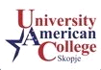
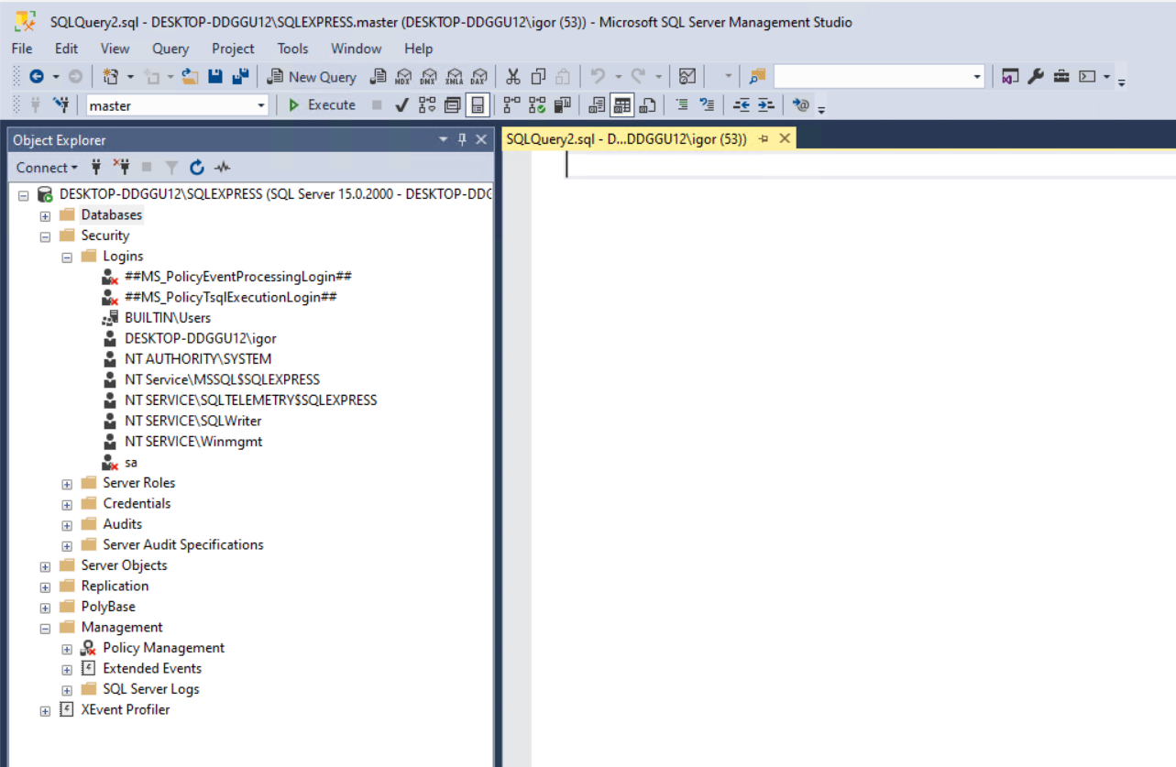
Tool strip
workspace
Object explorer

Slide 4
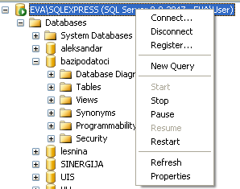
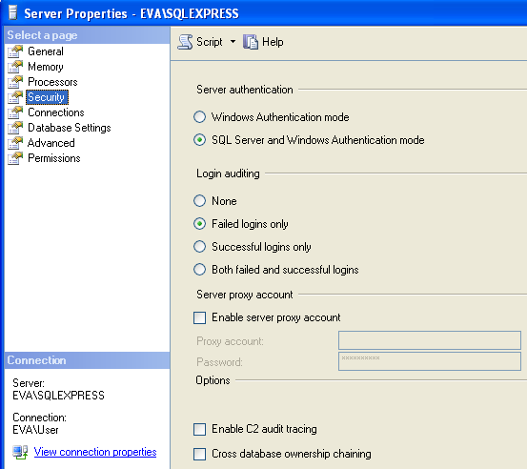
Working with SQL Server
Connect \ Disconnect
Register – rename SQL Server
Start/Stop/Pause…
Properties - Security
Security tab is used to define authentication, end product
Trusted Security Connection

Slide 5
Database Objects
DATABASE
Table
Schema
View
Function
Procedure
Trigger
Scripts

Slide 6
How to use Mng. Studio
Connect \ Disconnect
Register
Start/Stop/Pause…
Properties - Security
In Security you can define Server
Authentication type in order to
create so called Trusted Security
Connection

Slide 7
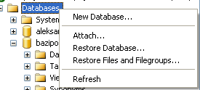
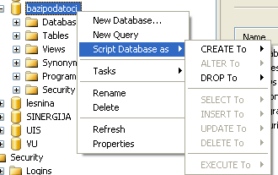
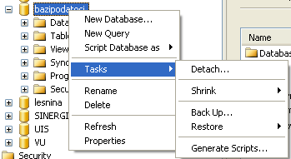
DataBase operations
New Database
Attach (*.mdf and *.ldf)
Restore (*.bak)
------------
Script DB As..
Detach
Shrink
Back up

Slide 8
Assignment
Create folder Database2 on drive C:\
Download 2 backup files from Moodle
Download 1 sql file from Moodle
Restore databases using backup files
Open SQL editor and execute commands from Geography.sql file
Create new Database DB2_Week2

Slide 9
Assignment
Enable SQL Authentication
Restart Your PC
  Change will affect with Service restart but due to access limitation we need perform PC restart
Create 3 sql users
  Sql1, sql2, sql3
Add sql1 as sysadmin to CompanyDB Database
Set up default DB to sql different that master DB

